Slide 1

Final Project
- CAFA 5 Protein Function Prediction
seok830621
5
off

Slide 2
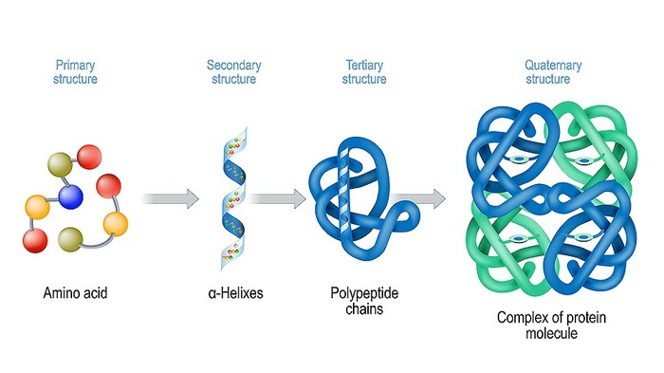
Final Project
- CAFA 5 Protein Function Prediction
seok830621
Topic
A
5
off
Proteins are extensive biomolecules and macromolecules that consist of one or more lengthy chains of amino acid residues. They carry out an immense array of functions within organisms and primarily vary from one another in terms of their sequence of amino acids. This sequence typically leads to the folding of proteins into a distinct 3D structure, which in turn dictates their activity.

Slide 3


Final Project
- CAFA 5 Protein Function Prediction
seok830621
Topic
A
5
off
Natural language processing (NLP) is an interdisciplinary subfield of computer science and linguistics. Its primary concern lies in providing computers with the capability to comprehend and manipulate speech using machine learning approaches. The objective is to enable a computer to comprehend the contents of documents, encompassing the contextual intricacies of the language used within them.
In analogy to NLP, these approaches interpret an entire protein sequence as a sentence and amino acids as single words. Protein sequences are constrained to adopt particular 3D structures optimized for accomplishing particular functions. These constraints mirror the rules of grammar and meaning in NLP.

Slide 4
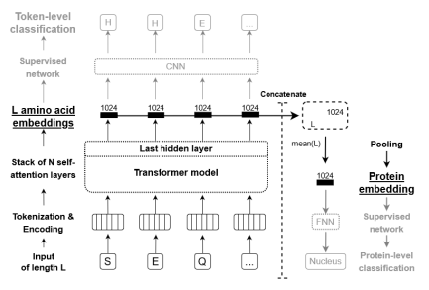
Final Project
- CAFA 5 Protein Function Prediction
seok830621
Topic
A
protein sequence is tokenized and positional encoding is added. The resulting vectors are passed through any of our ProtTrans models to create embeddings for each amino acid.
5
① CNN - > amino acid level embedding
These embeddings can be directly employed as inputs for prediction tasks at the level of individual tokens to predict the secondary structure of an amino acid.
off
②FNN -> protein level embedding
those embeddings can be concatenated and pooled along the length-dimension to get fixed-size embedding .The resulting protein-level embedding can be used as input for predicting aspects of proteins

Slide 5

Final Project
- CAFA 5 Protein Function Prediction
seok830621
Topic
A
5
off
Purpose
① Through this competition, we attempt to utilize natural language processing models to predict the functions of proteins.
② We aim to enhance the predictive accuracy by adjusting hyperparameters or fine-tuning the stages of the artificial neural
network.

Slide 6
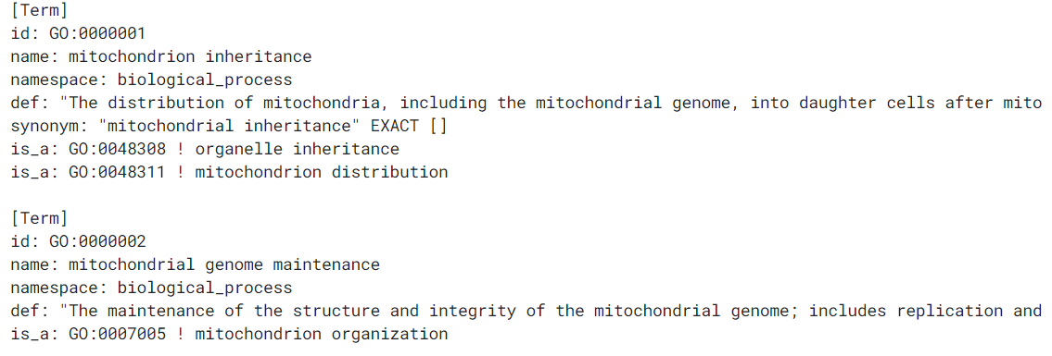
Final Project
- CAFA 5 Protein Function Prediction
seok830621
Data
B
5
1. Protein Function Information
off

Slide 7
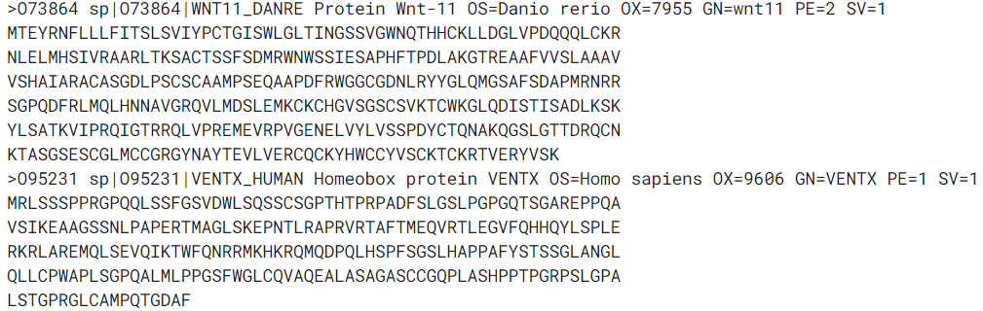
Final Project
- CAFA 5 Protein Function Prediction
seok830621
Data
B
Protein Name
Organism Species
Sequence Version
5
2. Protein Information – train & test dataset
Protein Existence
Organism Taxonomy ID
off
Gene Name
Protein Sequence

Slide 8
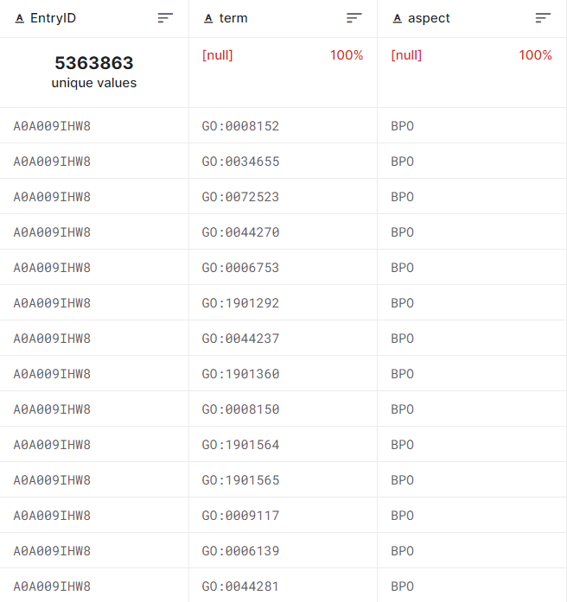
Final Project
- CAFA 5 Protein Function Prediction
seok830621
Data
B
3. Target Information
Protein Function ID
5
Protein ID
Protein Aspect
off

Slide 9
Final Project
- CAFA 5 Protein Function Prediction
seok830621
Pre-trained Model
C
5
Types of models
①T5 ②Electra ③BERT ④Albert ⑤Transformer-XL ⑥XLNet
The reason for model selection
① Because T5 model include the encoder and the decoder, T5 provides the
flexibility to apply different training methodologies and masking strategies.
② T5 allows the reconstruction of spans of tokens instead of individual tokens.
③ T5 learns a shared positional encoding for each attention head across all layers.
Through this mechanism, the model learns to integrate the relative offsets
between residue pairs from lower layers. As a result, the model becomes
capable of making predictions that extend beyond the actual length of the
positional encoding
off

Slide 10
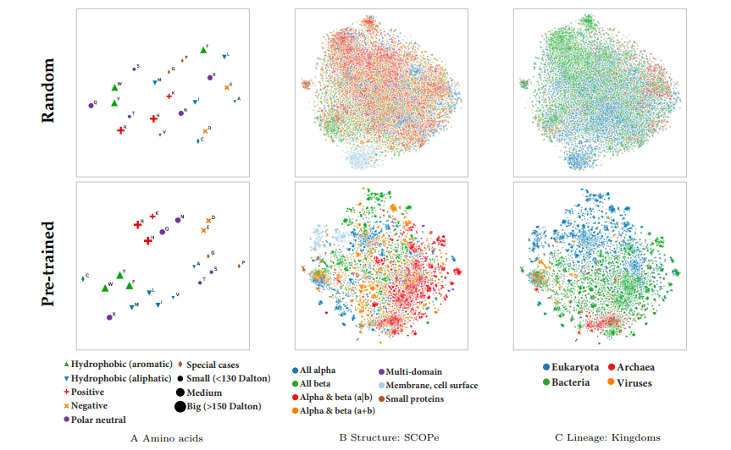
Final Project
- CAFA 5 Protein Function Prediction
seok830621
Pre-trained Model
C
ost impressive might be the fine-grained distinctions of biophysical features of amino acids (A), however, more surprising are the classifications of entire proteins according to structural class (B) and organism (C).
5
off
All three categories, (A), (B), and (C), have been more accurately classified, showcasing impressive results when we used the pre-trained models.

Slide 11
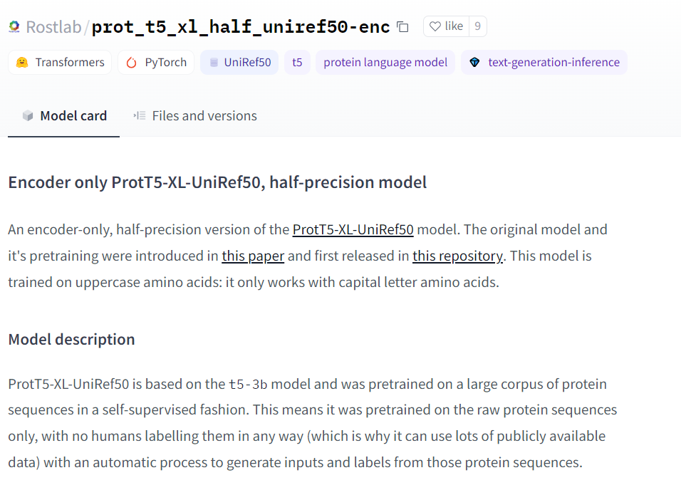
Final Project
- CAFA 5 Protein Function Prediction
seok830621
Pre-trained Model
C
5
off

Slide 12
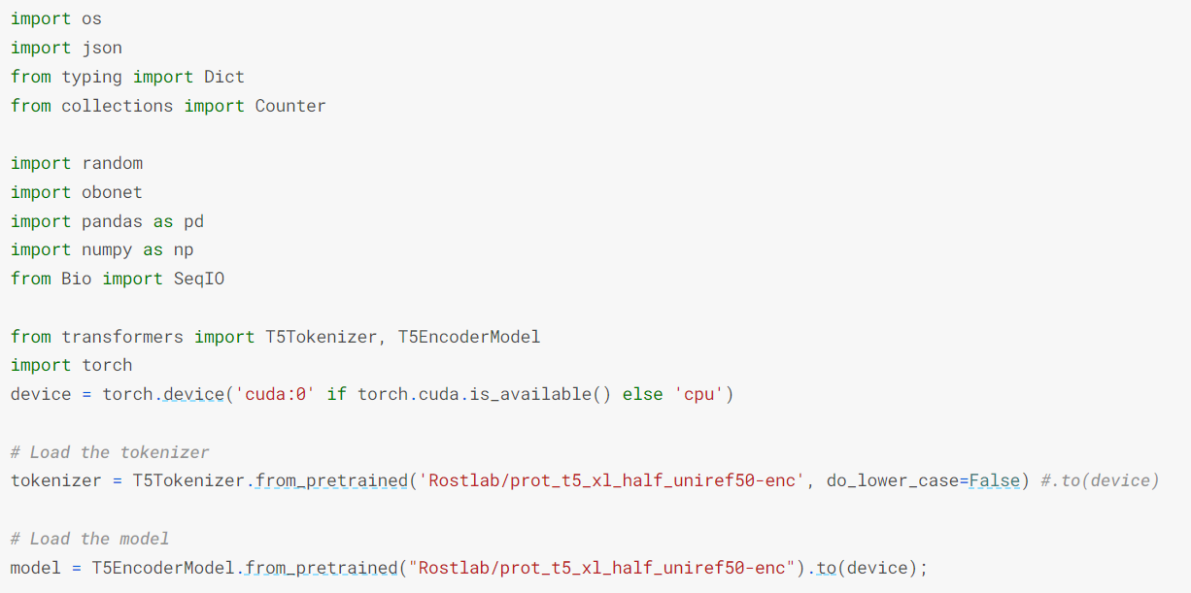
Final Project
- CAFA 5 Protein Function Prediction
seok830621
Data Pre-processing
D
5
off

Slide 13
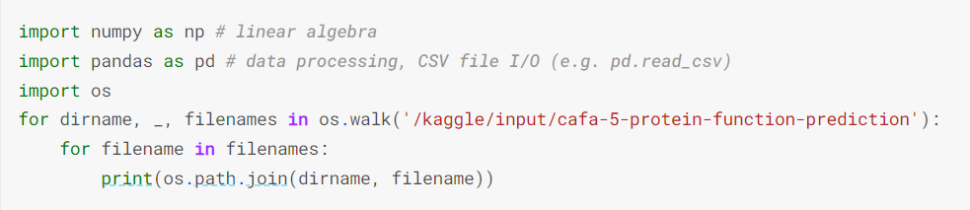

Final Project
- CAFA 5 Protein Function Prediction
seok830621
Data Pre-processing
D
5
off

Slide 14
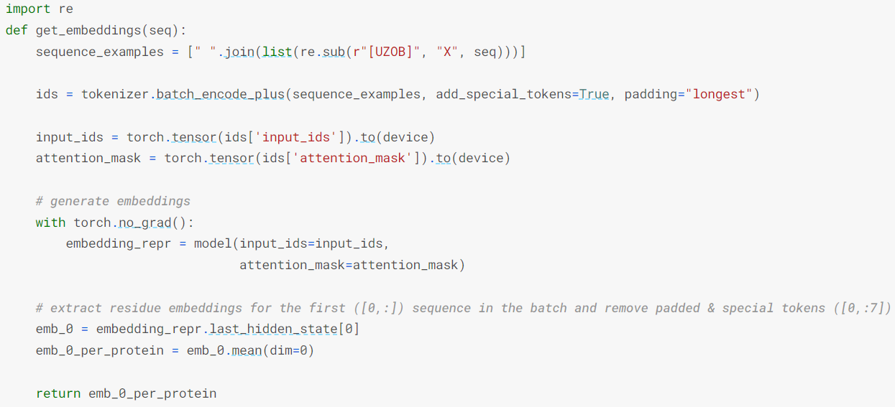
Final Project
- CAFA 5 Protein Function Prediction
seok830621
Data Pre-processing
D
5
off

Slide 15
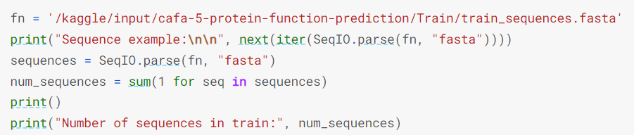
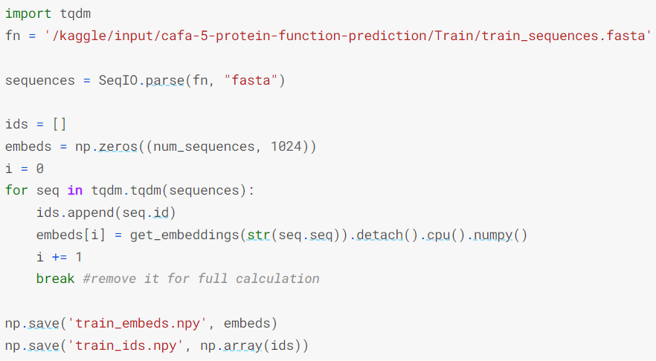
Final Project
- CAFA 5 Protein Function Prediction
seok830621
Data Pre-processing
D
5
off

Slide 16
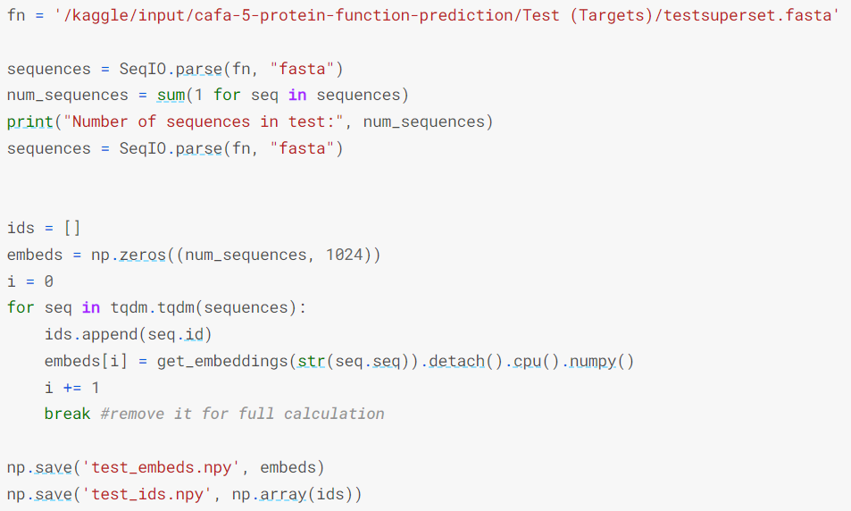
Final Project
- CAFA 5 Protein Function Prediction
seok830621
Data Pre-processing
D
5
off

Slide 17
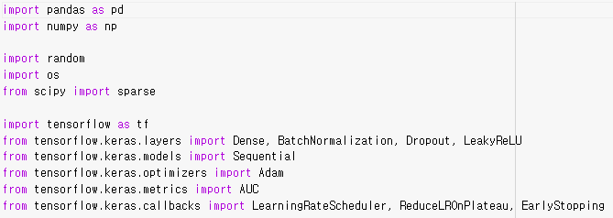
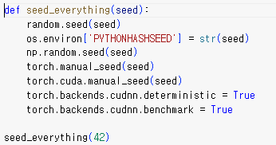
Final Project
- CAFA 5 Protein Function Prediction
seok830621
Model Training
E
5
off

Slide 18
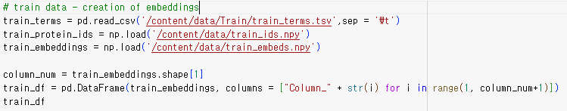
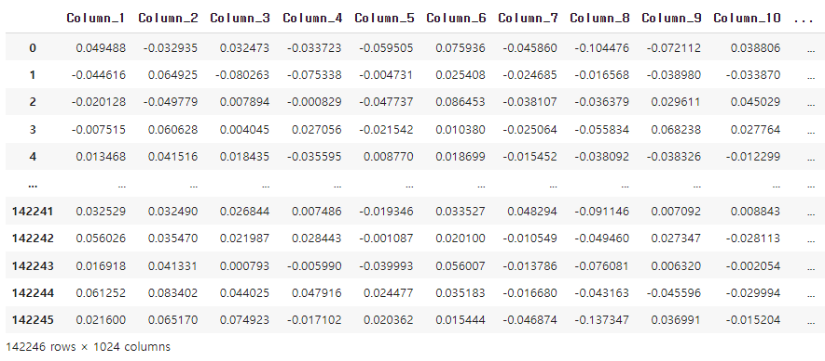
Final Project
- CAFA 5 Protein Function Prediction
seok830621
Model Training
E
5
off

Slide 19
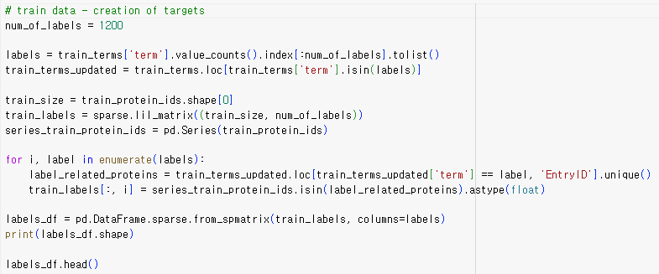
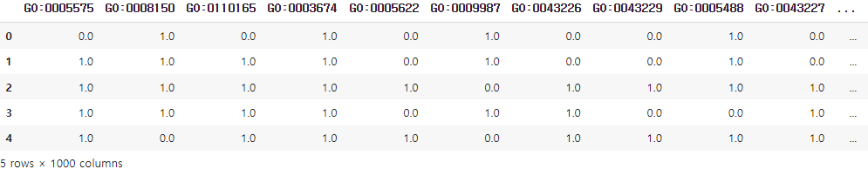
Final Project
- CAFA 5 Protein Function Prediction
seok830621
Model Training
E
5
off

Slide 20
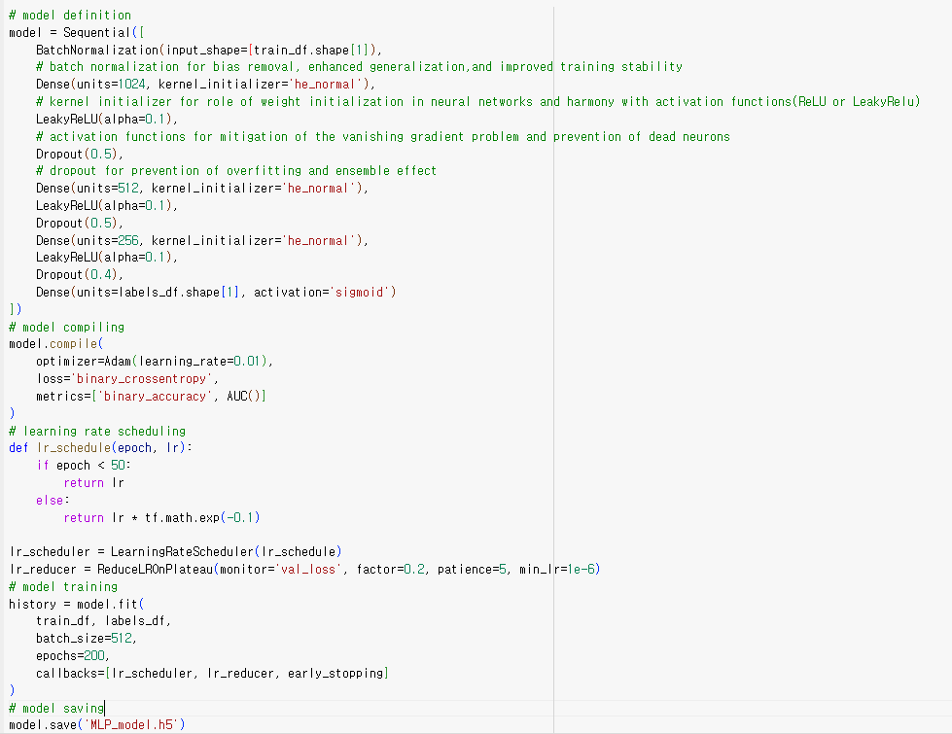
Final Project
- CAFA 5 Protein Function Prediction
seok830621
Model Training
E
5
off

Slide 21
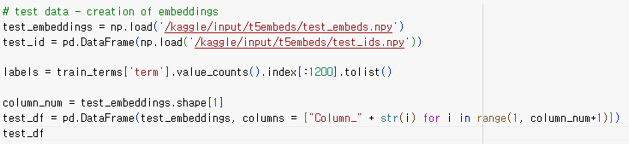
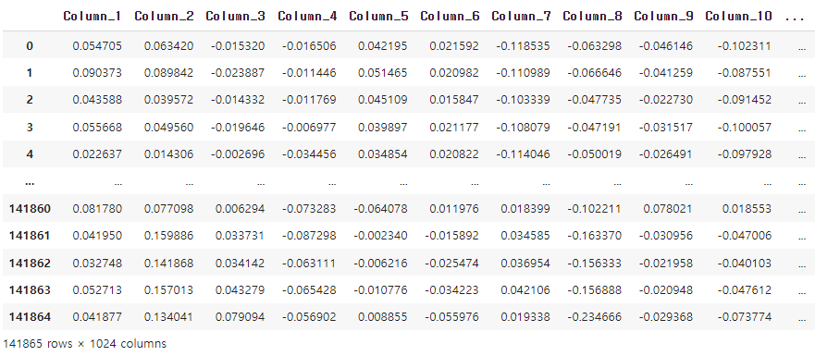
Final Project
- CAFA 5 Protein Function Prediction
seok830621
Model Prediction & Submission
F
5
off

Slide 22
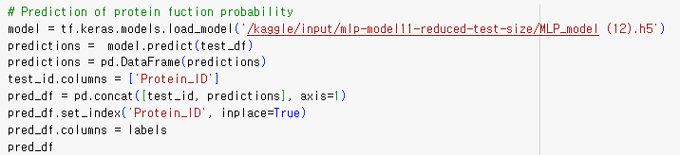
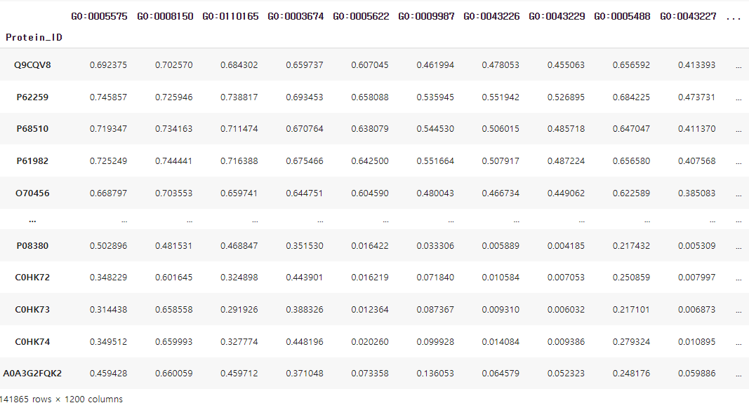
Final Project
- CAFA 5 Protein Function Prediction
seok830621
Model Prediction & Submission
F
5
off

Slide 23
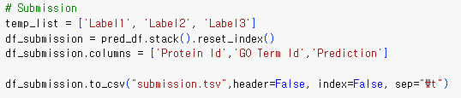
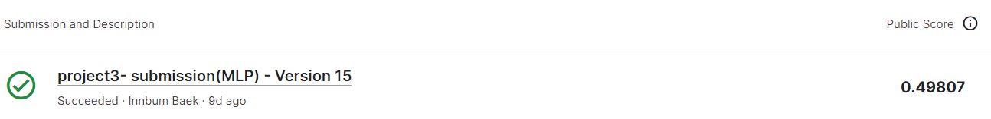
Final Project
- CAFA 5 Protein Function Prediction
seok830621
Model Prediction & Submission
F
5
off
Evaluation Metrics
-> Weighted F- Score : an evaluation metric used in multi-class classification problems
For each class, the F1 score is calculated using the following formula: F1 score = 2 * (precision * recall) / (precision + recall)
The weighted F-score takes into accounts the class distribution or importance and computes an average F1 score while
applying class-specific weights.

Slide 24
Final Project
- CAFA 5 Protein Function Prediction
seok830621
Improvements
G
① Creating a model that predicts which aspect among the three protein aspects it will have, and
developing models based on protein aspects, appears to lead to more accurate predictions.
② Due to insufficient RAM usage in the virtual notebook environment, predictions were conducted
using the top 1200 functions possessed by the largest number of proteins. However, in this competition,
the objective is to predict 1500 proteins. Expanding the prediction to cover 1500 proteins could
potentially yield better predictive results.
③ Using PCA or autoencoders to reduce the dimensions of the numerical embeddings, which consist of
1024 values for each protein, could have resulted in better outcomes by minimizing unnecessary
components and addressing multicollinearity.
5
off
References
H
① Elnaggar, A., Heinzinger, M., Dallago, C., Rehawi, G., Wang, Y., Jones, L., ... & Rost, B. (2020). ProtTrans: Towards Cracking
the Language of Life’s Code Through Self-Supervised Learning. preprint. Bioinformatics, July.
② Sergeev, A., & Del Balso, M. (2018). Horovod: fast and easy distributed deep learning in TensorFlow. arXiv preprint
arXiv:1802.05799.

Slide 25
Final Project
- CAFA 5 Protein Function Prediction
seok830621
5
Thank you
off

